Slide 1
Tsunamis

Slide 2
What causes tsunamis?
Most tsunamis are caused by earthquakes generated in a subduction zone, an area where an oceanic plate is being forced down into the mantle by plate tectonic forces.
The friction between the subducting plate and the overriding plate is enormous. This friction prevents a slow and steady rate of subduction and instead the two plates become "stuck".

Slide 3
Energy accumulates in the overriding plate until it exceeds the frictional forces between the two stuck plates. When this happens, the overriding plate snaps back into an unrestrained position.
This sudden motion is the cause of the tsunami - because it gives an enormous shove to the overlying water. At the same time, inland areas of the overriding plate are suddenly lowered.

Slide 4
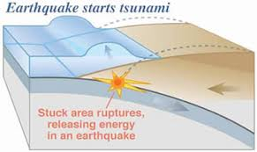

Slide 5
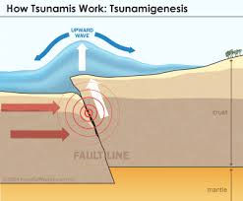

Slide 6
How does it generate the wave?
The moving wave begins travelling out from where the earthquake has occurred. Some of the water travels out and across the ocean basin, and, at the same time, water rushes landward to flood the recently lowered shoreline.

Slide 7
How fast do they travel?
Where the ocean is over 20,000 feet deep, unnoticed tsunami waves can travel at the speed of a commercial jet plane, nearly 600 miles per hour. They can move from one side of the Pacific Ocean to the other in less than a day.
Scientists can predict when a tsunami will arrive since the speed of the waves varies with the square root of the water depth. Tsunamis travel much slower in shallower coastal waters where their wave heights begin to increase dramatically.

Slide 8
How big do they get?
Reefs, bays, entrances to rivers, undersea features and the slop of the beach all help to modify the tsunami as it attacks the coastline. When the tsunami reaches the coast and moves inland, the water level can rise many feet.
In extreme cases, water level has risen to more than 50 feet for tsunamis of distant origin and over 100 feet for tsunami waves generated near the earthquake's epicenter. The first wave may not be the largest in the series of waves.

Slide 9
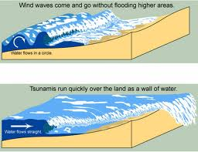
Tsunami compared with normal waves

Slide 10
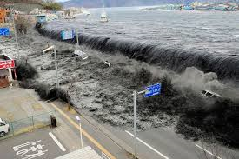
Japan Tsunami

Slide 11
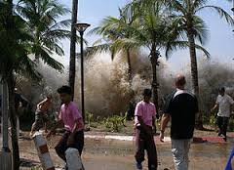
Boxing day tsunami

Slide 12
What can cause a tsunami?
Tsunamis can be caused by all of the following:
1. Earthquake
2. Landslide
3. Asteroid or Meterorite

Slide 13
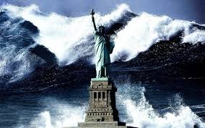
Here is one from the 2012 New York earthquake that destroyed the world, oh wait that has not happened, yet!?

