Slide 1
Earthquakes and their causes

Slide 2
Review: What is a fault?
Faults are fractures in the bedrock where sliding has taken place.
Active faults have had movement in the last 11,000 years.
Most faults are no longer active.

Slide 3
Types of Faults
Dip-slip fault
Normal fault
Reverse fault
Thrust fault
Strike-slip fault
Right-lateral fault
Left-lateral fault
Oblique-slip fault

Slide 4
What are Earthquakes?
A trembling or shaking of the ground caused by the sudden release of energy stored in rocks that get stuck with one another along faults
Seismic Waves: The waves of energy produced by an earthquake that cause the ground to tremble and shake

Slide 5
Where do earthquakes occur?
They occur at areas in which large plates move against each other.
Most occur along subduction zones, or transverse faults
Sometimes they occur in areas that seem very stable, for example Missouri.

Slide 6
Measuring the Size of an Earthquake
Intensity: A measure of the earthquake’s effect on people and buildings.
Measured by the Modified Mercalli Scale

Slide 7
Measuring the Size of an Earthquake
Magnitude: A measure of the energy released during the earthquake. The larger the magnitude, the more the ground vibrates
Measured by the Richter scale

Slide 8
Richter Magnitude | Description | Maximum Expected Mercalli Intensity at Epicenter | Annual Expected Number
2.0 | Very minor: Not felt by humans | I – Usually detected by instruments | 600,000
2.0-2.9 | Very minor: Rarely felt by humans | I-II Felt by some indoors, especially on upper floors | 300,000
3.0-3.9 | Minor earthquake: felt by humans | III Felt indoors | 49,000
4.0-4.9 | Light earthquake: some property damage | IV-V Felt by most; slight damage | 6,200
5.0-5.9 | Moderate earthquake: property damage | VI-VII Felt by all; damage minor to moderate | 800
6.0-6.9 | Strong earthquake: damage in billions of dollars and loss of life | VII-VIII Everyone runs outdoors; moderate to major damage | 266
7.0-7.9 | Major Earthquake: severe economic damage Large loss of life | IX-X Major damage | 18
8.0 or higher | Great earthquake: near total destruction Massive loss of life | X-XII Major and total damage | 1 or 2

Slide 9
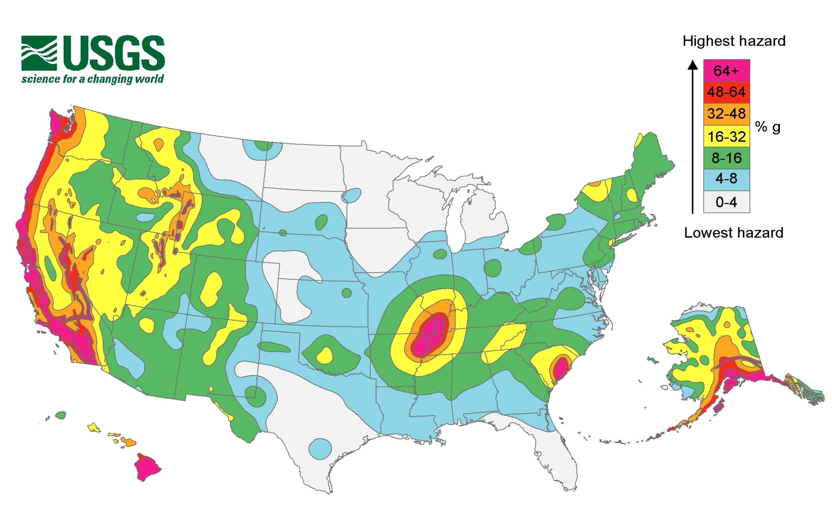
Hazard Map
Notes:
http://www.google.com/imgres?q=map+of+earthquakes+in+2011&um=1&hl=en&safe=active&biw=1152&bih=626&tbm=isch&tbnid=9qzJOctzhoFzZM:&imgrefurl=http://thedailyviz.com/post/9299628995/mapping-2011-earthquakes&docid=42eIgkgLe2BZjM&imgurl=http://earthquake.usgs.gov/hazards/products/graphic2pct50.jpg&w=2250&h=1500&ei=QtoNT7eEGsWxiQLQ9ryrDQ&zoom=1&iact=hc&vpx=507&vpy=329&dur=1221&hovh=183&hovw=275&tx=111&ty=129&sig=106697503119442250330&page=2&tbnh=111&tbnw=167&start=18&ndsp=19&ved=1t:429,r:3,s:18

Slide 10
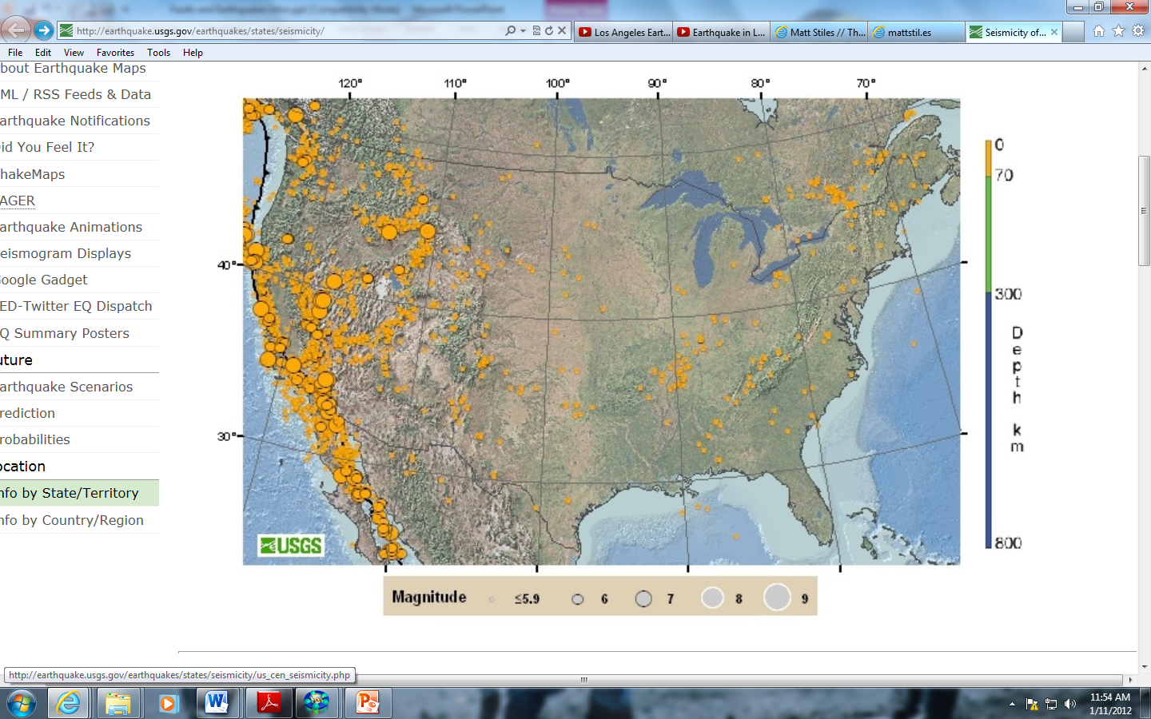
Frequency of Earthquakes
Notes:
http://earthquake.usgs.gov/earthquakes/states/seismicity/

Slide 11
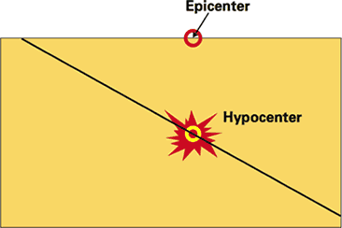
What is an epicenter?
The epicenter is the point on the earth's surface vertically above the hypocenter (or focus), point in the crust where a seismic rupture begins.

Slide 12
What is an hypocenter
The hypocenter is the point within the earth where an earthquake rupture starts. The epicenter is the point directly above it at the surface of the Earth. Also commonly termed the focus.

Slide 13
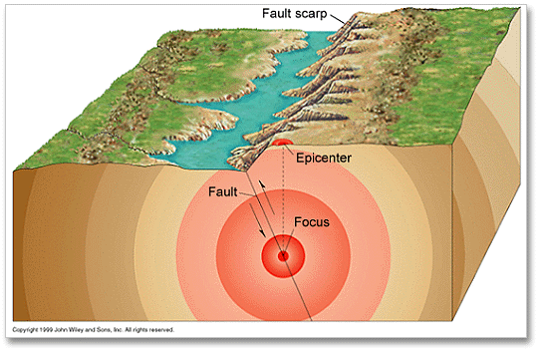
Another example of epicenter and focus

Slide 14
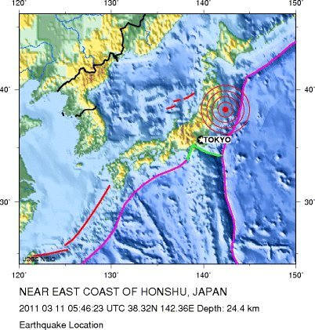
Epicenter of Japan Earthquake

Slide 15
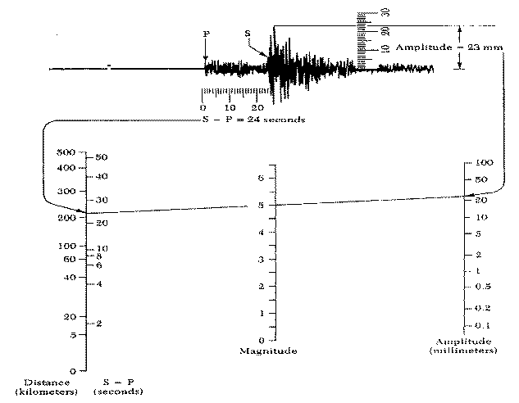
Determining magnitude

Slide 16
Calculating magnitude
Measure the distance to the focus using the time interval between the S and the P waves (here S-P = 24 seconds).
Measure the height of the maximum wave motion on the seismogram (23 millimeters).
Place a straight edge between the appropriate points on the distance (left) and amplitude (right scales to obtain magnitude M_{L} = 5.0.

Slide 17
How much bigger is a magnitude 8.7 earthquake than a magnitude 5.8 earthquake?
A magnitude 8.7 earthquake is 794 times BIGGER on a seismogram than a magnitude 5.8 earthquake. The magnitude scale is logarithmic, so:
10**8.7)/(10**5.8) = (5.01*10**9)/(6.31*10**6) = .794*10**3 = 794 OR = 10**(8.7-5.8) = 10**2.9 = 794.328
Another way to get about the same answer without using a calculator is that since 1 unit of magnitude is 10 times the amplitude on a seismogram and 0.1 unit of magnitude is about 1.3 times the amplitude, we can get,
10 * 10 * 10 / 1.3 = 769 times [not exact, but a decent approximation]

Slide 18
What is the magnitude scale really measuring?
The magnitude scale is really comparing amplitudes of waves on a seismogram, not the STRENGTH (energy) of the quakes.
So, a magnitude 8.7 is 794 times bigger than a 5.8 quake as measured on seismograms, but the 8.7 quake is about 23,000 times STRONGER than the 5.8! Since it is really the energy or strength that knocks down buildings, this is really the more important comparison. This means that it would take about 23,000 quakes of magnitude 5.8 to equal the energy released by one magnitude 8.7 event.

Slide 19
Here's how we get that number:
One whole unit of magnitude represents approximately 32 times (actually 10**1.5 times) the energy, based on a long-standing empirical formula that says log(E) is proportional to 1.5M, where E is energy and M is magnitude. This means that a change of 0.1 in magnitude is about 1.4 times the energy release. Therefore, using the shortcut shown earlier for the amplitude calculation, the energy is,
32 * 32 * 32 / 1.4 = 23,405 or about 23,000

Slide 20
So I know what a lot of you have been thinking, how much bigger is a 10 than a 5?
A magnitude 10 is 100,000 times bigger then a magnitude 5,
However it is 31,622,776 times stronger

Slide 21
Seismic Waves
Body Waves: Waves that travel through the Earth’s interior and spread out in all directions
There are two types of waves, P waves and S waves

Slide 22
P-Wave
Primary, first wave to hit stations
Compressional (or Longitudinal) wave in which rock vibrates back and forth in parallel to the direction of wave propagation
Fastest wave, travels 4-7 kilometers per second.

Slide 23
S-Wave
The second type of body wave is the S wave or secondary wave, which is the second wave you feel in an earthquake.
An S wave is slower than a P wave and can only move through solid rock. It is this property of S waves that led seismologists to conclude that the Earth's outer core is a liquid. S waves move rock particles up and down, or side-to-side--perpendicular to the direction that the wave is traveling in.

Slide 24
Surface Waves
There are two different kinds of surface waves:
Love waves
Rayleigh waves

Slide 25
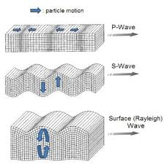

Slide 26
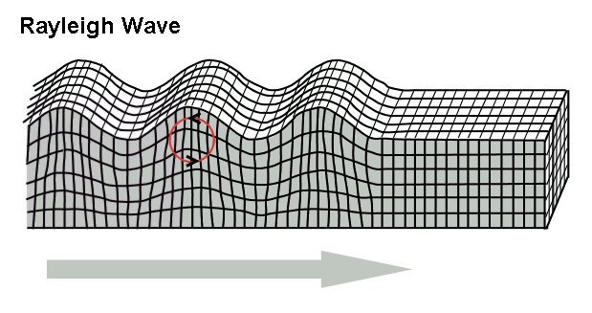
Rayleigh waves
A Rayleigh wave is a seismic surface wave causing the ground to shake in an elliptical motion, with no transverse, or perpendicular, motion
http://www.youtube.com/watch?v=uapYIUxWCDk

Slide 27
Some great links
http://www.ted.com/talks/peter_haas_haiti_s_
http://www.youtube.com/watch?v=9X-js9gXSMEdisaster_of_engineering.html
http://www.youtube.com/watch?v=iZoHoPFHAtw
http://www.youtube.com/watch?v=7W40_EolH4s
http://www.youtube.com/watch?v=VHtrMq617gk

